Slide 1
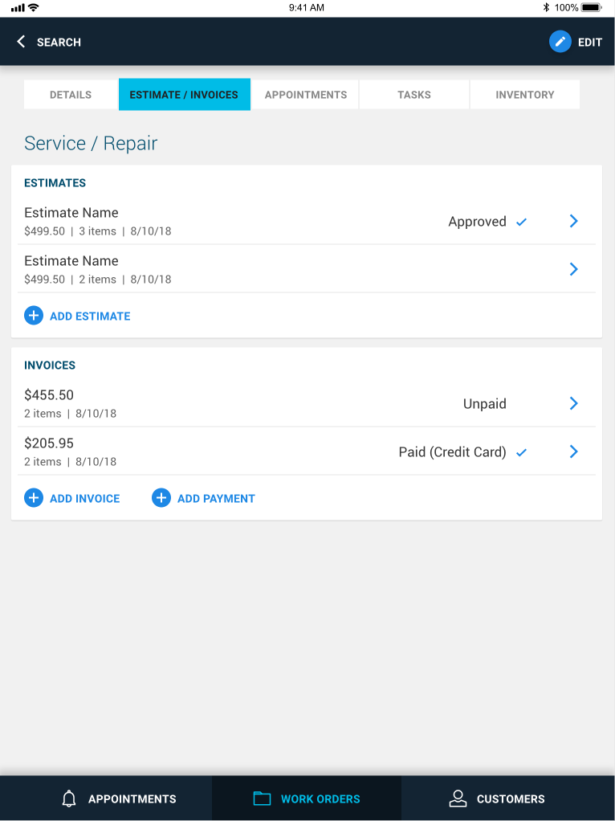
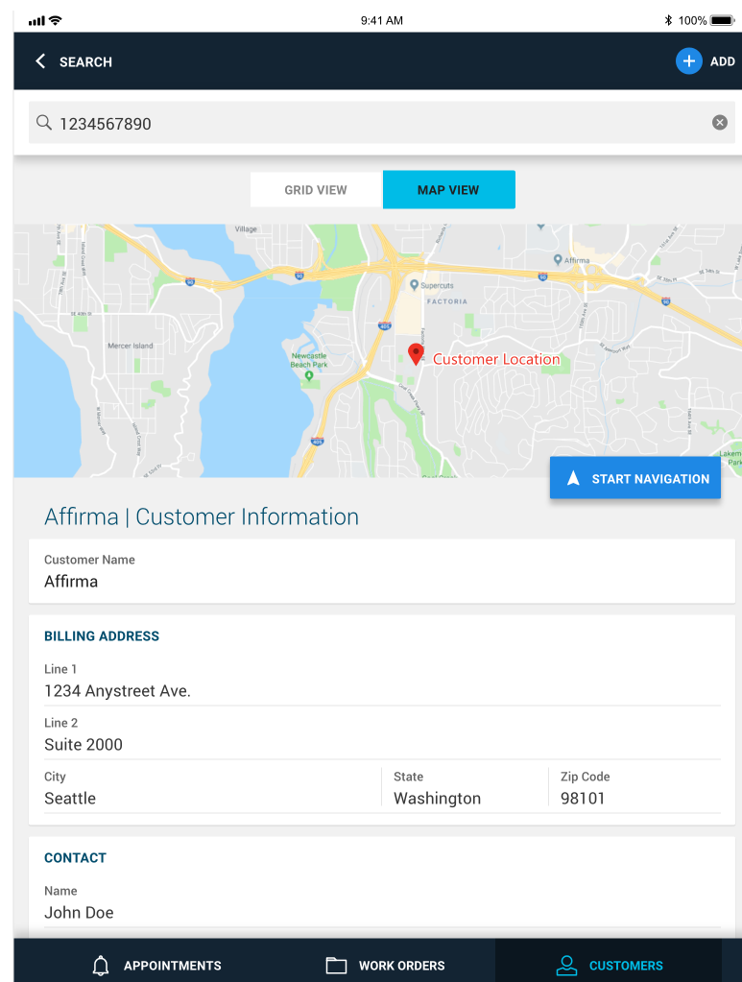
HVAC Field Service Application
Business Need
The client needed a field service app that integrated with their ERP and allowed technicians to work fully offline. Technicians had to manage schedules, customer data, estimates, and orders in the field, with all updates syncing back to the ERP once internet access was restored.
Outcomes
iOS app for technicians and web portal for administrators
Full offline functionality to capture data and place orders anywhere
Automatic sync with ERP when connectivity is regained
Accurate, up-to-date data without duplicate entry
Successfully deployed and actively supported by Affirma’s development team

